Slide 1
GenAI HW5
LLM Fine-tuning
TA: 陳光銘 林熙哲 余奇恩
ntu-gen-ai-2024-spring-ta@googlegroups.com
Deadline: 2024/04/11 23:59:59 (UTC+8)

Slide 2
Outline
Link
Sample code link
Sample code link (breeze)
Score parsing program link
Tang poem dataset
MediaTek DaVinci
TA Hour meet:
https://meet.google.com/wzt-mneb-dcm
https://meet.google.com/xdk-temq-thz
Task Overview
TODOs
Decoding Parameter
Submission and Grading
Reference and Appendix

Slide 3
Task Overview

Slide 4
Task Overview
We want an AI model to be able to write Tang poems
Give the AI the first two sentences, we want it to continue the rest
冰清玉澈水，風送香氣移
AI model that can write Tang Poems
雪霽銀妝素，桔高映瓊枝

Slide 5
Task Overview
AI model may not be good at writing Tang Poems
我不懂你的意思，請再重複一次。
AI model that can’t write Tang Poems
雪霽銀妝素，桔高映瓊枝
Notes:
補上原本FT前 可能的output

Slide 6
Task Overview
In this task, we will want to teach the AI model to write Tang Poems
我不懂你的意思，請再重複一次。
冰清玉澈水，風送香氣移
AI model that can’t write Tang Poems
AI model that can write Tang Poems
Teach
雪霽銀妝素，桔高映瓊枝
雪霽銀妝素，桔高映瓊枝

Slide 7
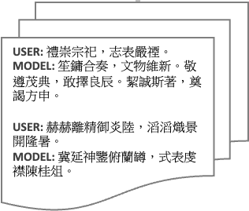
How to Teach AI to Write Poem
We collect data of poems, and teach the AI model to continue the Tang Poem given the first two sentences
我不懂你的意思，請再重複一次。
冰清玉澈水，風送香氣移
AI model that can write Tang Poems
Teach
AI model that can write Tang Poems
雪霽銀妝素，桔高映瓊枝
雪霽銀妝素，桔高映瓊枝

Slide 8
Generating Poem from an AI that Can Generate Poem
Model may generate diverse poems when giving the same first two sentences?
霜葉紅於血，秋風思故里
冰清玉澈水，風送香氣移
晨光破霧照，遠山含翠微
AI model that can write Tang Poems
雪霽銀妝素，桔高映瓊枝

Slide 9
What You Will Learn in This Task
How to teach an AI model to do specific task
How to modify some hyperparameters (to be explained later) of the AI model to change how it generate the texts
Notes:
不一定是解釋唐詩 只要倒其他資料，就可以變成可以做其他任務的LLM

Slide 10
Homework - 會寫唐詩的GPT
Sample code link

Slide 11


Overall Workflow
Taide-7B
1. Fine-tune the model
Fine-tuned model
Any other models you can run
2. Generate Poems
AI
We use generative AI as a TA to evaluate your poems automatically.
Generative AI TA [批改助教] Info :
1. Platform: MediaTek DaVinci
2. Model: GPT-4
3. Evaluate your Poems

Slide 12
TODOs
Decide the number of training data to fine-tune your own LLＭ model
Tuning decoding parameters to generate 15 Tang poems
Submit your generated poems to GenAI Homework5 Assistant
Notes:
是續寫 不是generate conti

Slide 13
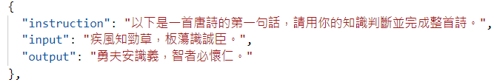
Model and Dataset
Dataset : Tang poem dataset
Model :
In the sample code, we use Taide-7B. (Taide model will be released in mid-April. Please do not share this model with anyone outside of this class before that date.)
Feel free to select another large language model for fine-tuning
Data example:
ref: chinese-poetry

Slide 14
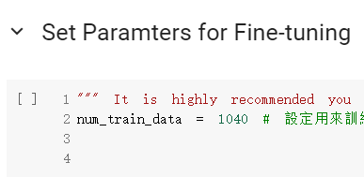
Number of Training Data
In the sample code, we set 1040 data to fine tune LLM.
Try a larger number to achieve better performance (but also training longer)
There are total 5000 Tang poems.
Notes:
In the sample code, we set 1040 data to fine tune LLM. 在样例代码中，我们设置了1040个数据来微调LLM。
Try a larger number to achieve better performance (but also training longer) 尝试更大的次数来获得更好的表现（但也要训练更长时间）
There are total 5000 Tang poems. 唐诗共有5000首。

Slide 15
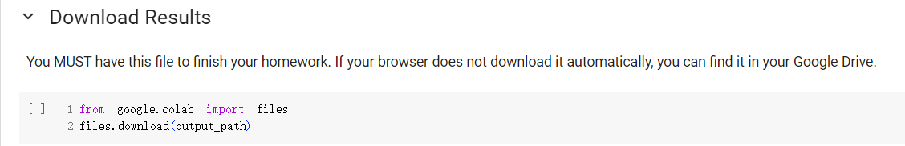
2. Generate 15 poems from test set
After running the last block of sample code, you would get a result.txt
Copy the generated poem and submit to Davinci assistant.

Slide 16
Changing the Generation Behavior:
Decoding Parameters

Slide 17
Generation from Language Models is Sampling
When generating from a language model, we sample a token from the next-token distribution to determine what the next token is
冰
月
水
風
林
AI model that can write Tang Poems
雪霽銀妝素，桔高映瓊枝

Slide 18
Generation from Language Models is Sampling
By changing how we sample from this distribution, we can change how the language model generates the next token
冰
月
水
風
林
AI model that can write Tang Poems
雪霽銀妝素，桔高映瓊枝

Slide 19
Commonly Used Parameters
When using LLM for generation, there are some hyperparameters:
temperature
Top-k
Top-p
max_length
We can adjust these hyperparameters to control the behaviors of LLM. e.g., longer vs. shorter; diverse vs. static
Notes:
We can adjust these hyperparameters to control the behaviors of LLM. e.g., longer vs. shorter; diverse vs. static 我们可以通过调整这些超参数来控制LLM的行为。如。，较长与较短；多样化vs静态

Slide 20
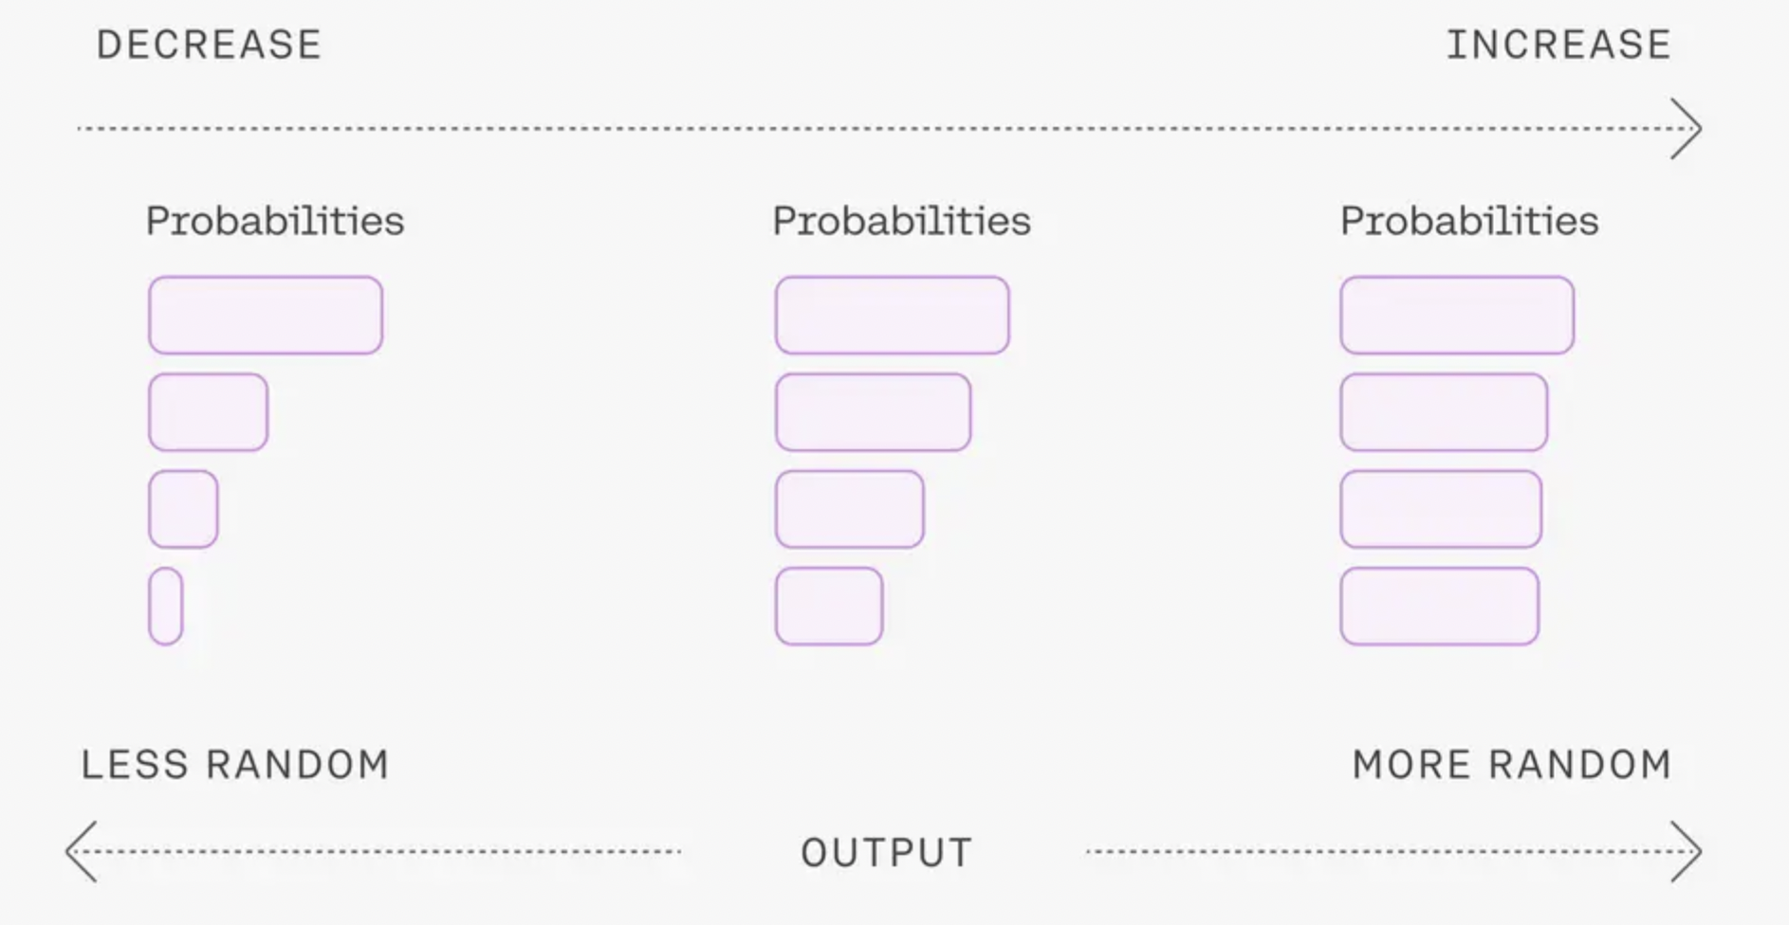
Temperature
Related to the diversity of the output, 0.0 ≤ temperature
Higher temperature for better diversity
Temperature Value
風
風
風
冰
冰
冰
林
林
林
月
月
月
Ref.
Notes:
temperature 值越大，模型就 diverse，也就是模型每次的输出都不同
temperature 值越小，模型就 static，也就是模型每次的输出都相同或者比较接近

Slide 21

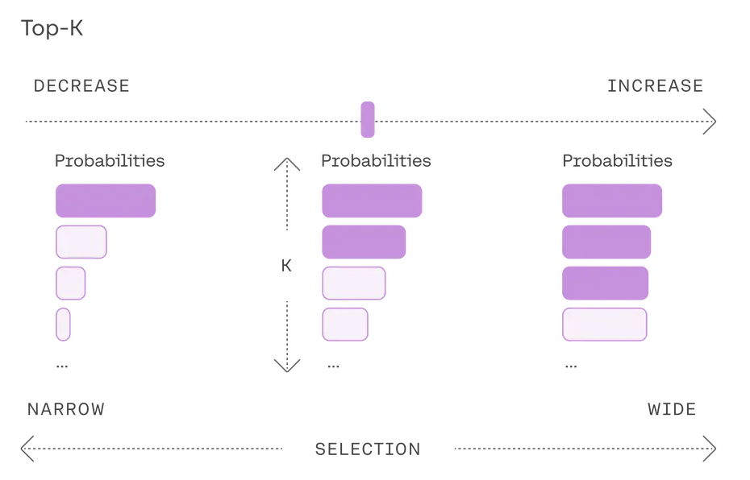
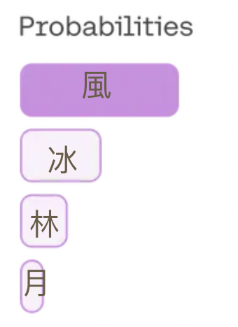
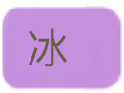



Top-K
Number of selection when LLM makes decision for each word
Top-K Value
風
風
風
冰
冰
冰
冰
冰
Top-K is a positive integer
林
林
林
林
月
月
月
K=1
K=2
K=3
Ref.

Slide 22
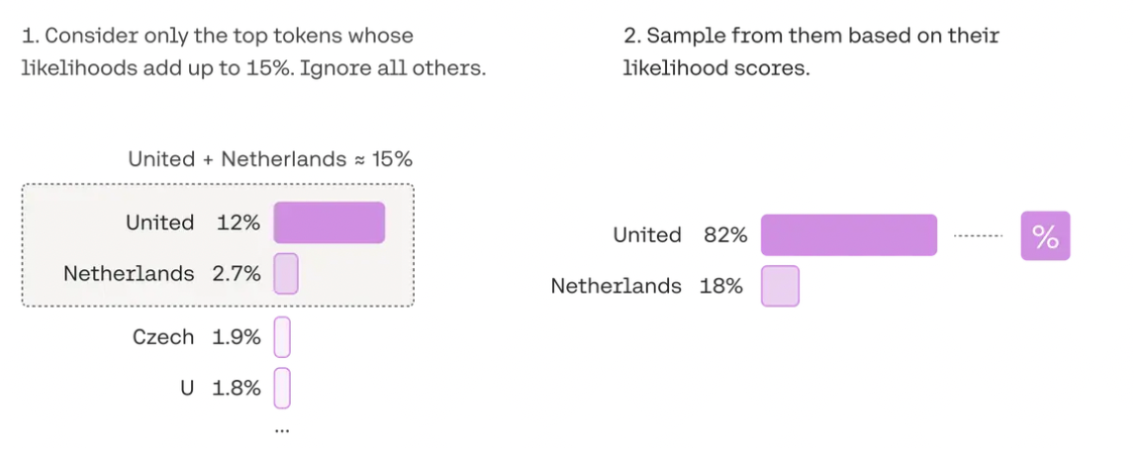


Top-P
p = 0.15
風 + 冰
風
風
冰
冰
林
月
0.0 ≤ Top-P ≤ 1.0
Ref.

Slide 23
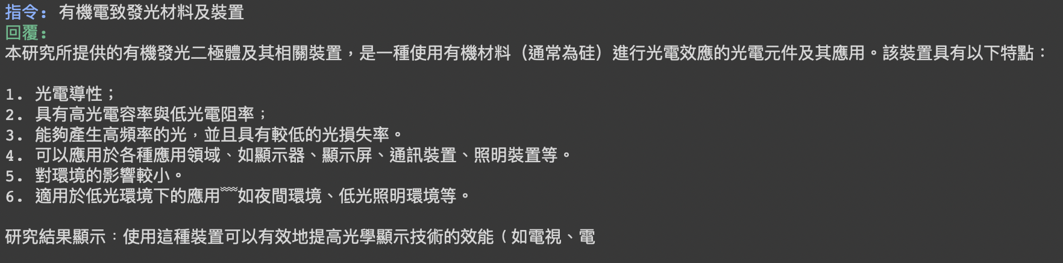
Max_length
The max length of the generated token sequence.
If you found that the generated sentence seems truncated, check max_length!

Slide 24
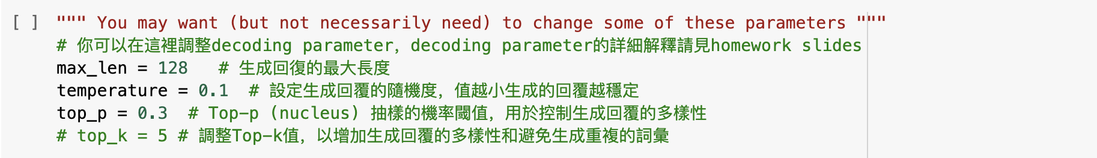
Tuning decoding parameters (advanced)
You are encouraged to tune decoding parameters to generate higher quality Tang poems.

Slide 25
Homework - 會寫唐詩的GPT
Demo
Sample code link

Slide 26
Homework - 會寫唐詩的GPT
Re-run experiment

Slide 27
Re-run experiment
If you are unsatisfied with the results of your experiment, you may want to fine-tune the parameters of your training.
Following the steps to avoid some errors
Step 1. Click "重新啟動工作階段" (“Restart session”)
Step 2. Change the hyperparameters or others
Step 3. Run the blocks shown in the following slides

Slide 28
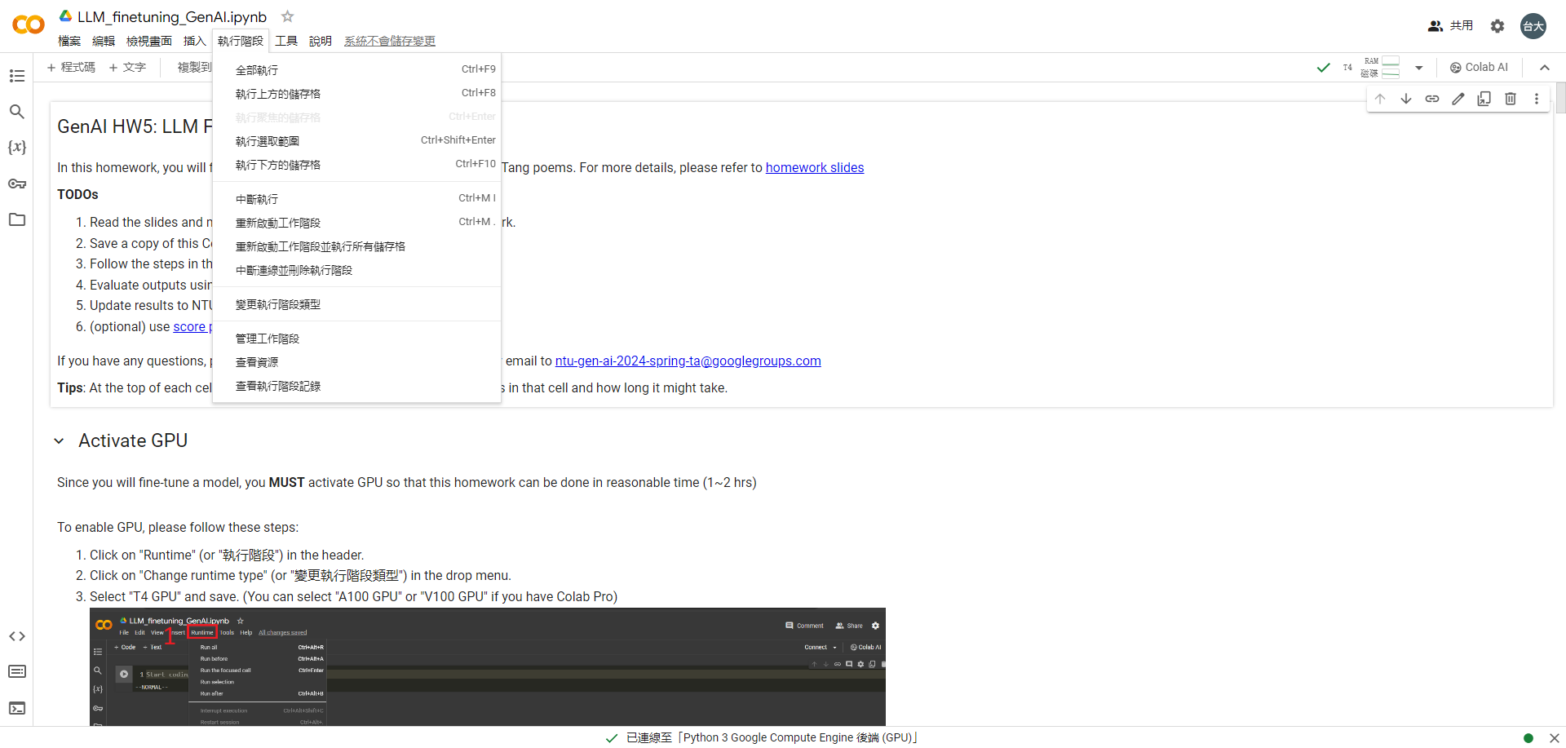
1. click "重新啟動工作階段"

Slide 29
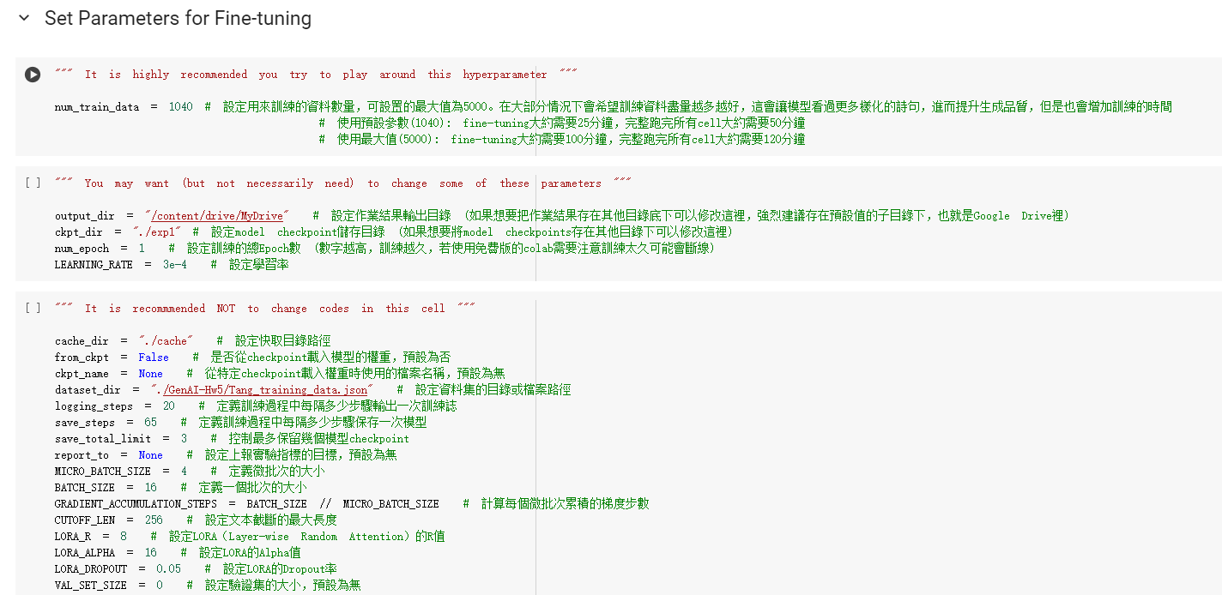
2. you may have some changes here

Slide 30
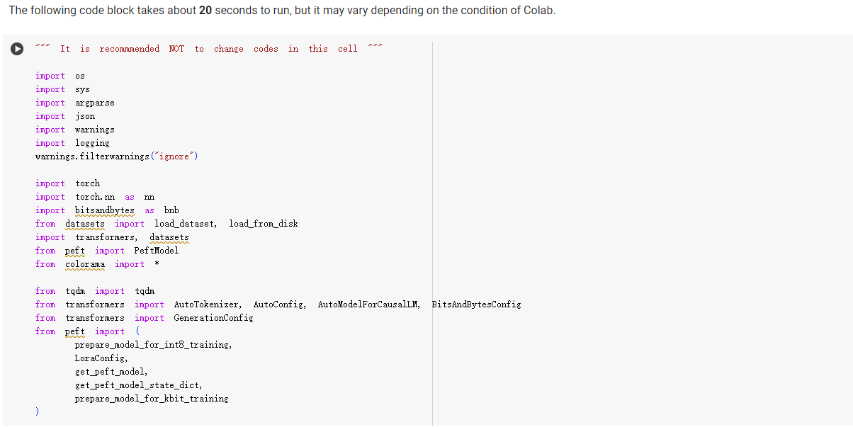
3. run this block

Slide 31
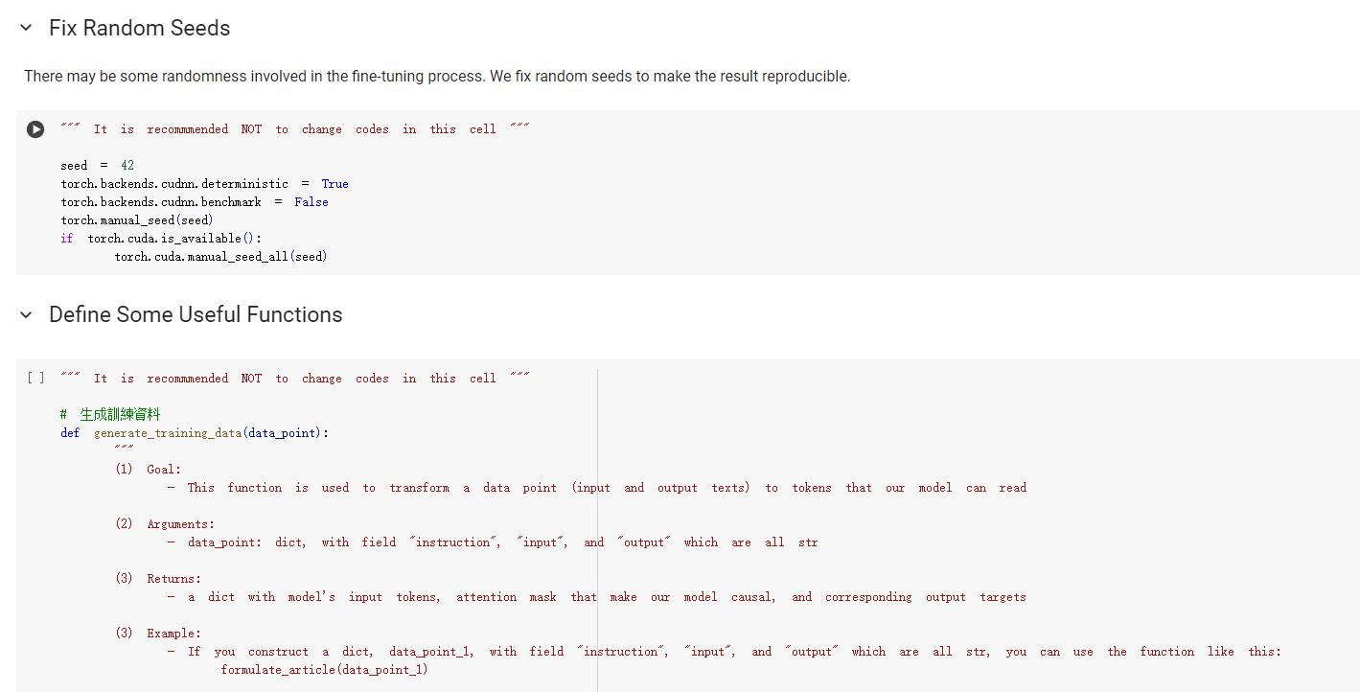
4. run these two blocks

Slide 32
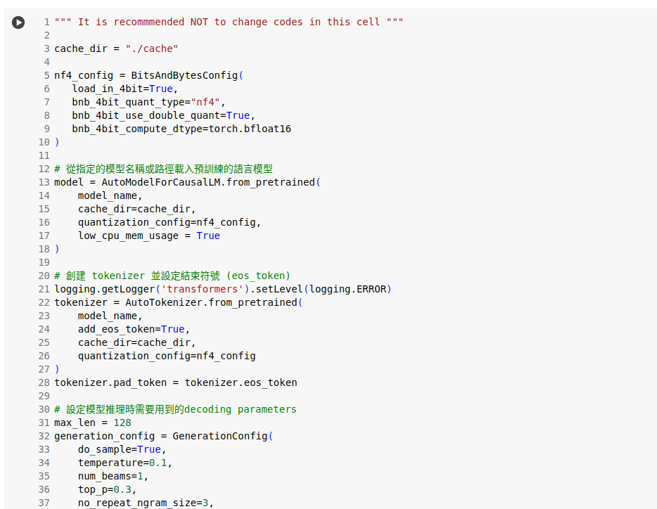
4. run this block

Slide 33
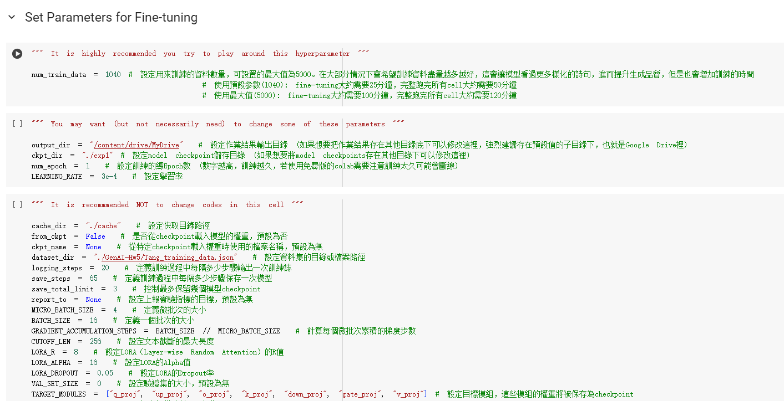
4. run these three blocks

Slide 34
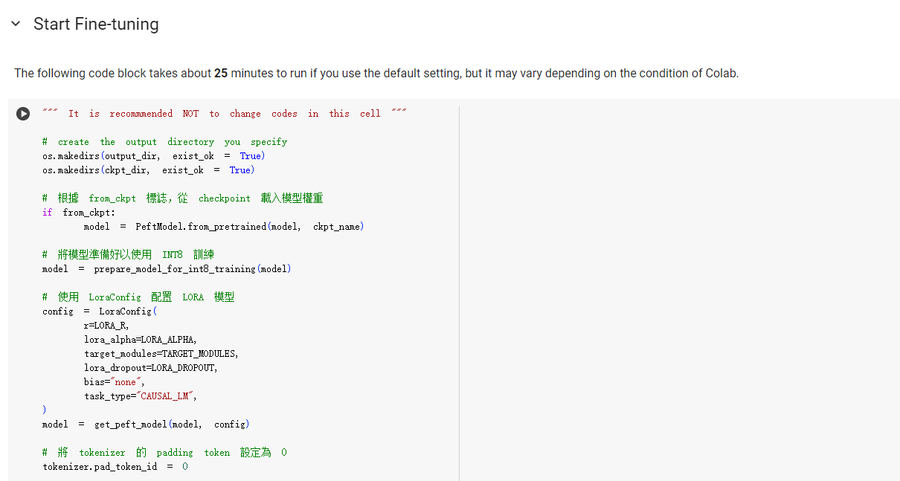
5. run this block and all the blocks below it, and you’ll
obtain the results using the training hyperparameter setting

Slide 35
Submission and Grading

Slide 36
Workflow
Taide-7B
1. Fine-tune the model
Fine-tuned model
Any other models you can run
2. Generate Poems
AI
We use generative AI as a TA to evaluate your poems automatically.
Generative AI TA [批改助教] Info :
1. Platform: MediaTek DaVinci
2. Model: GPT-4
3. Evaluate your Poems

Slide 37
Grading Policy - HW Score
Total 10 point :
Format of the poem (5%)
Content of the poem (5%)
Save your LLM output into results.txt and copy to Davinci assistant

Slide 38


Poem Evaluation
We employ evaluation assistants (批改助教) on MediaTek DaVinci platform
We prepare evaluation prompts including evaluation criteria and steps
15 poems need to be evaluated
Evaluation Prompt +
15 Poems
Evaluation Assistant
Assessment Result (Score)

Slide 39
Evaluation Settings in Evaluation Assistants
Platform
MediaTek DaVinci Platform
Model
GPT-4-turbo
Hyperparameters
Temperature Precise

Slide 40
Grading Policy - Content of the Poem(5%)
Scoring prompt: Evaluation Prompt in DaVinci(達哥)
The score is based on the poem’s coherence of phrases, appropriateness of vocabulary, clarity of expression, poetic qualities
Scoring
More than 10 poems have a score ≥ 7 points → 5%
8 to 9 poems have a score ≥ 7 points → 4%
6 to 7 poems have a score ≥ 7 points → 3%
4 to 5 poems have a score ≥ 7 points → 2%
2 to 3 poems have a score ≥ 7 points → 1%
Below 1 poem have a score ≥ 7 points → 0%

Slide 41
Grading Policy - Format of the Poem(5%)
Scoring prompt: Evaluation Prompt in DaVinci(達哥)
The score is based on the poem’s poetic form and structure, number of characters and syllables, sentence structure and line breaks
Scoring
More than 10 poems have a score ≥ 8 points → 5%
8 to 9 poems have a score ≥ 8 points → 4%
6 to 7 poems have a score ≥ 8 points → 3%
4 to 5 poems have a score ≥ 8 points → 2%
2 to 3 poems have a score ≥ 8 points → 1%
Below 1 poem have a score ≥ 8 points → 0%

Slide 42
Grading – How to do evaluation
Demo

Slide 43
Grading – How to do evaluation
Step 1: Install Evaluation Assistants

Slide 44
Evaluation Assistants
In Homework 5, you just need one evaluation assistant:
GenAI Homework5 Assistant
⚠️ Please utilize the appropriate assistant to evaluate your poems. Otherwise, your evaluation results will be deemed invalid and you will not receive any score.
⚠️ We will only parse the first response in the conversation for grading.

Slide 45
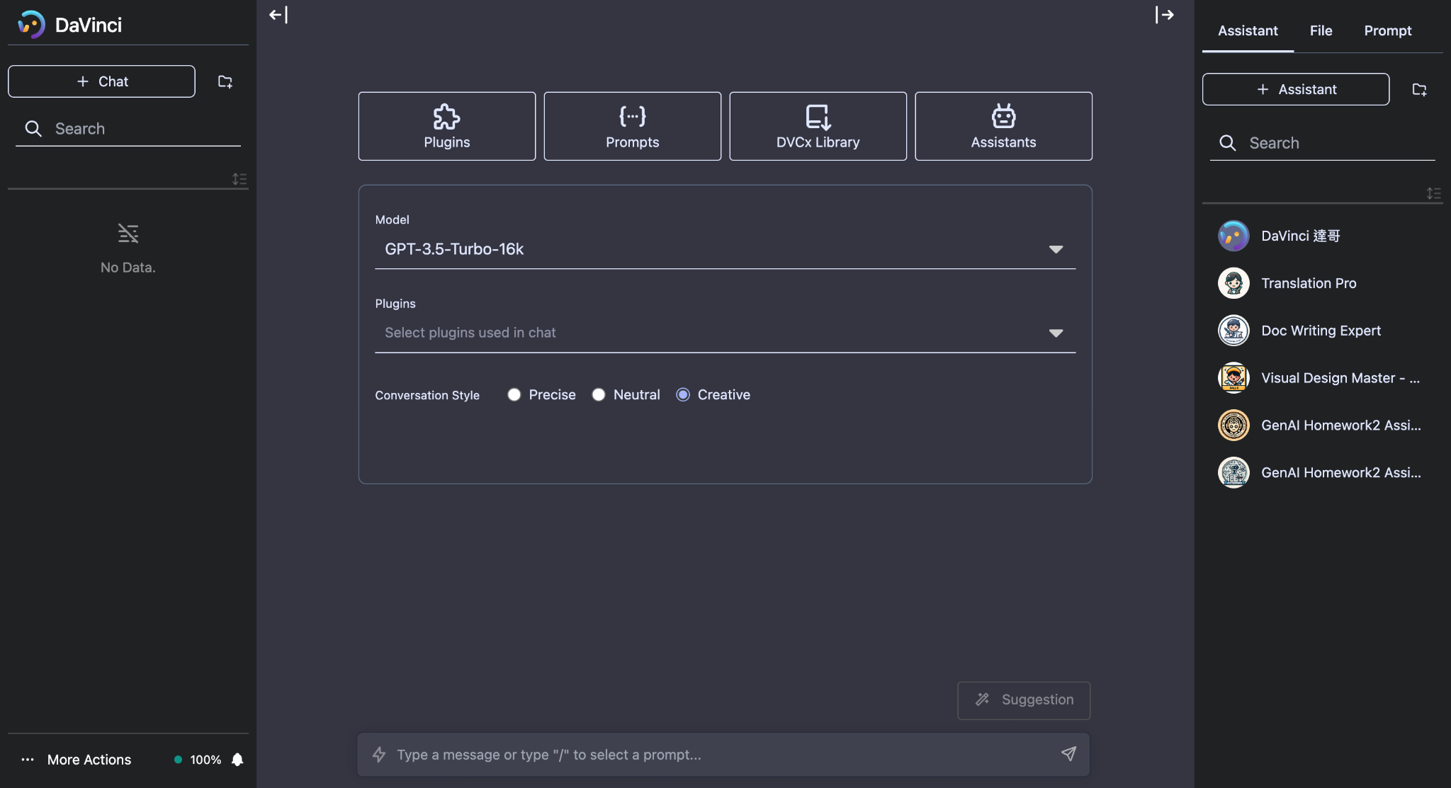
1. Create a new chat
2. Check assistant store

Slide 46
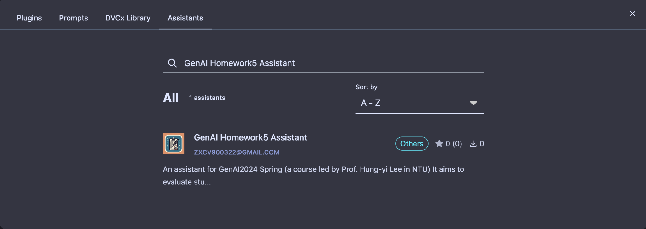
3. Search the name of the assistant
4. Click your target assistant

Slide 47
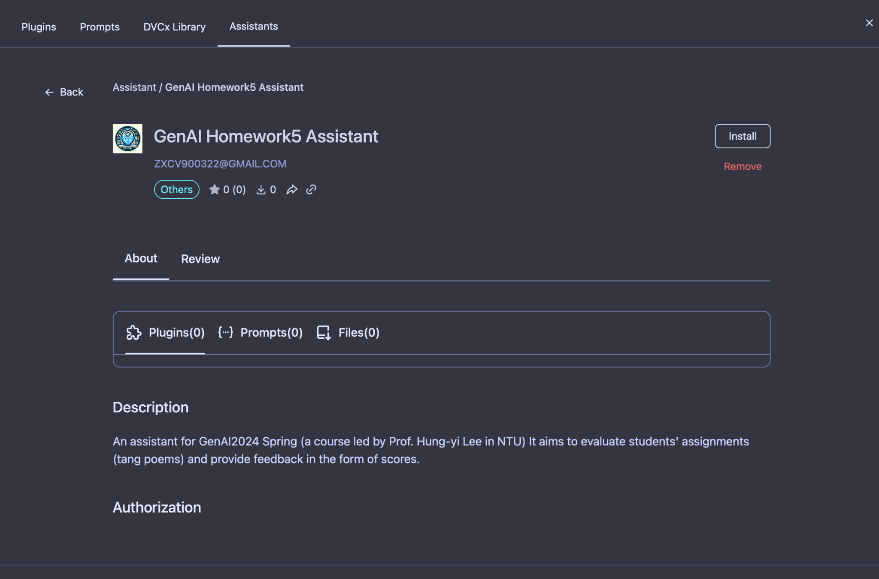
5. Install

Slide 48
Grading – How to do evaluation
Step 2: Use Assistants to Evaluate Poems

Slide 49
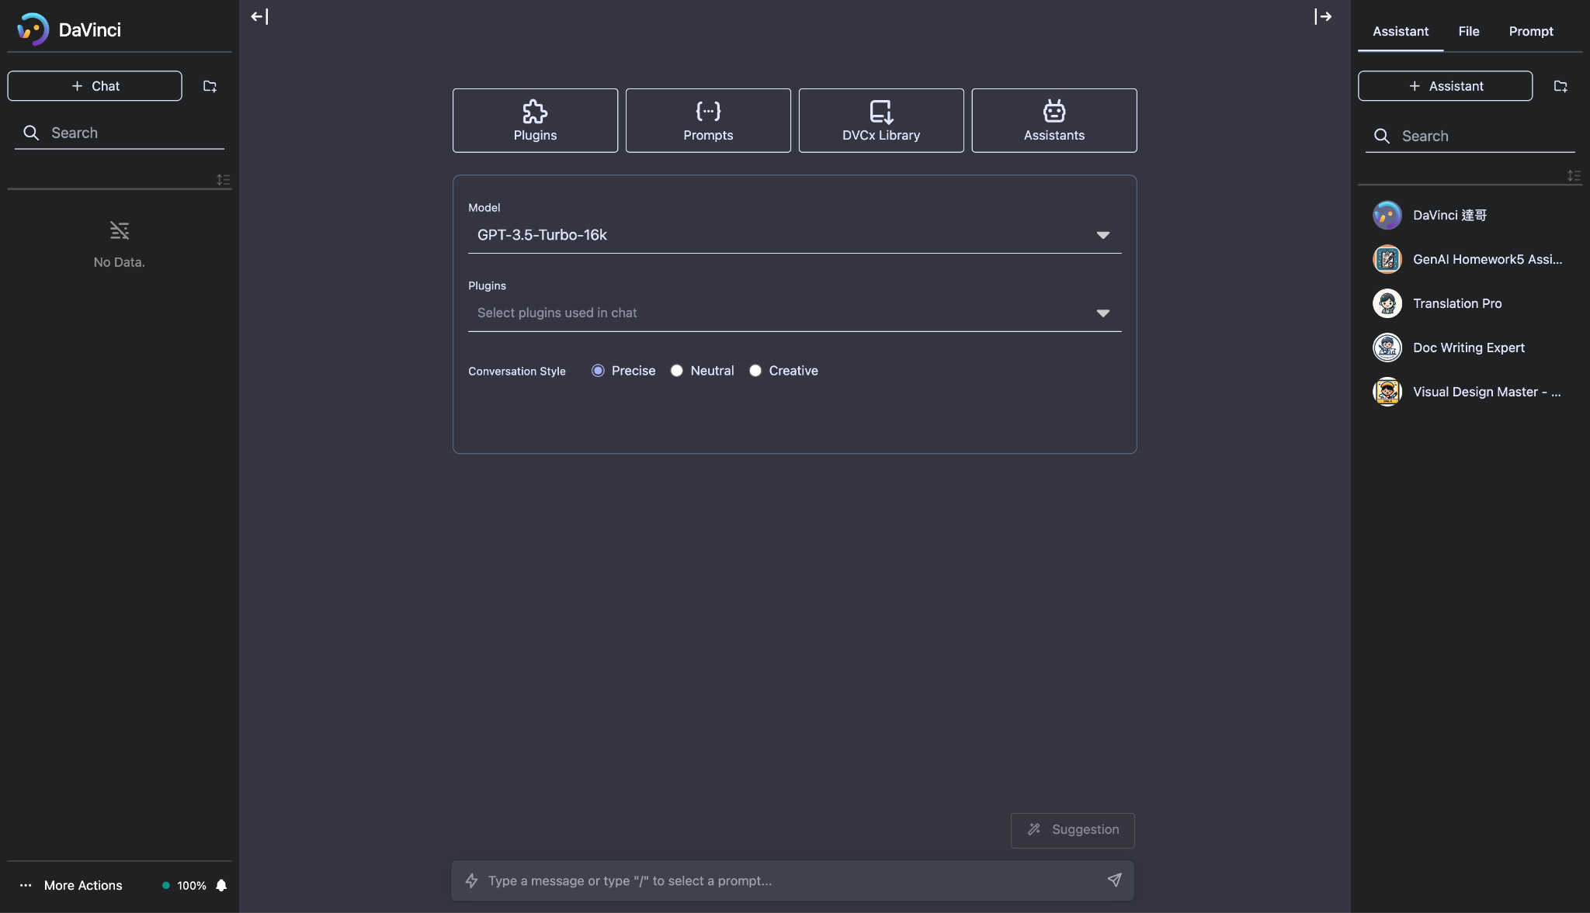
1. Create a new chat for each poem evaluation
2. Check the installed assistants
3. Click your target assistant
(GenAI Homework5 Assistant)
⚠️ Ensure to open a NEW chat every time you re-evaluate the result

Slide 50
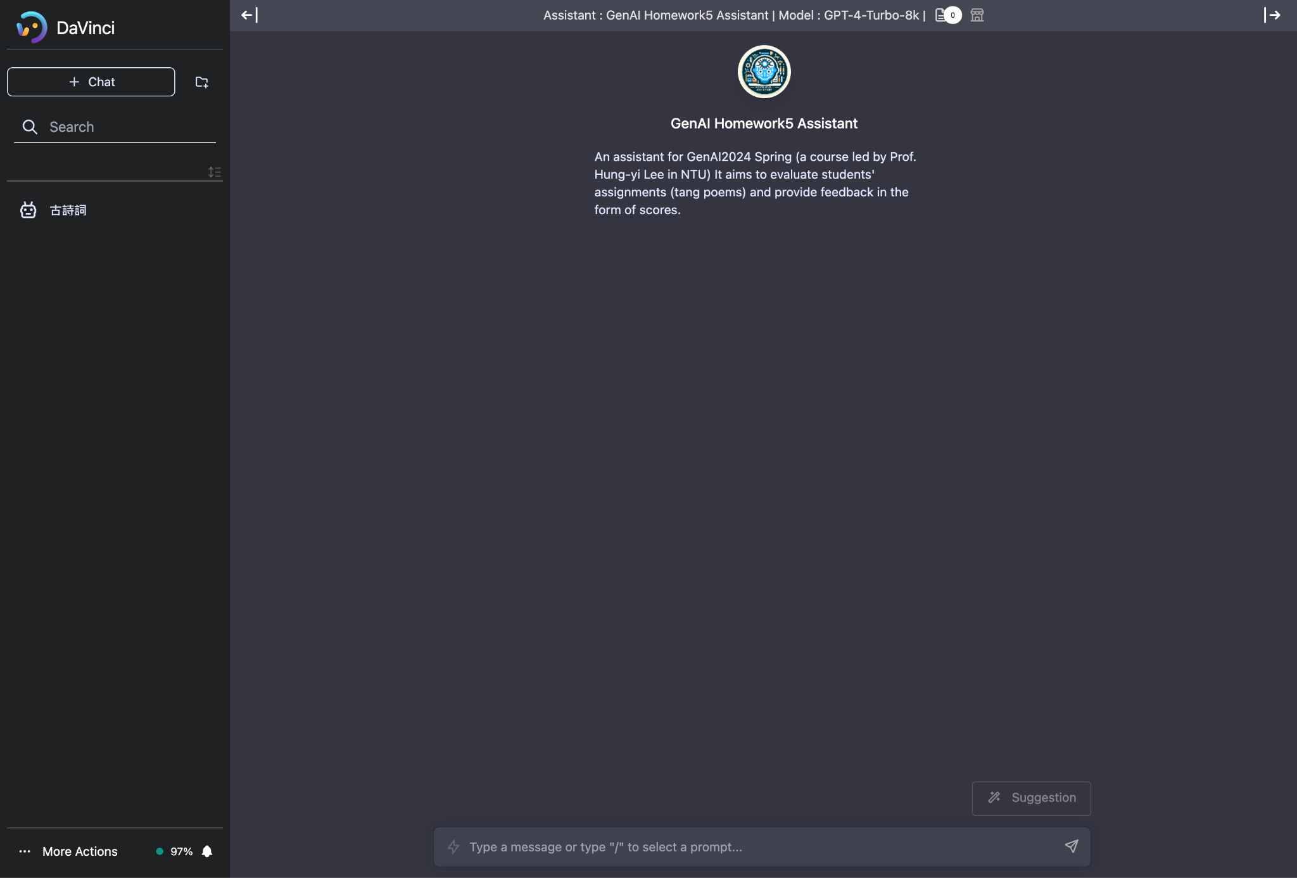
⚠️ Submitting the poems each time uses up your daily quota. About 10 tries of evaluations can be conducted in total each day. (Each try have 15 poems)
4. Directly input your all poems here

Slide 51
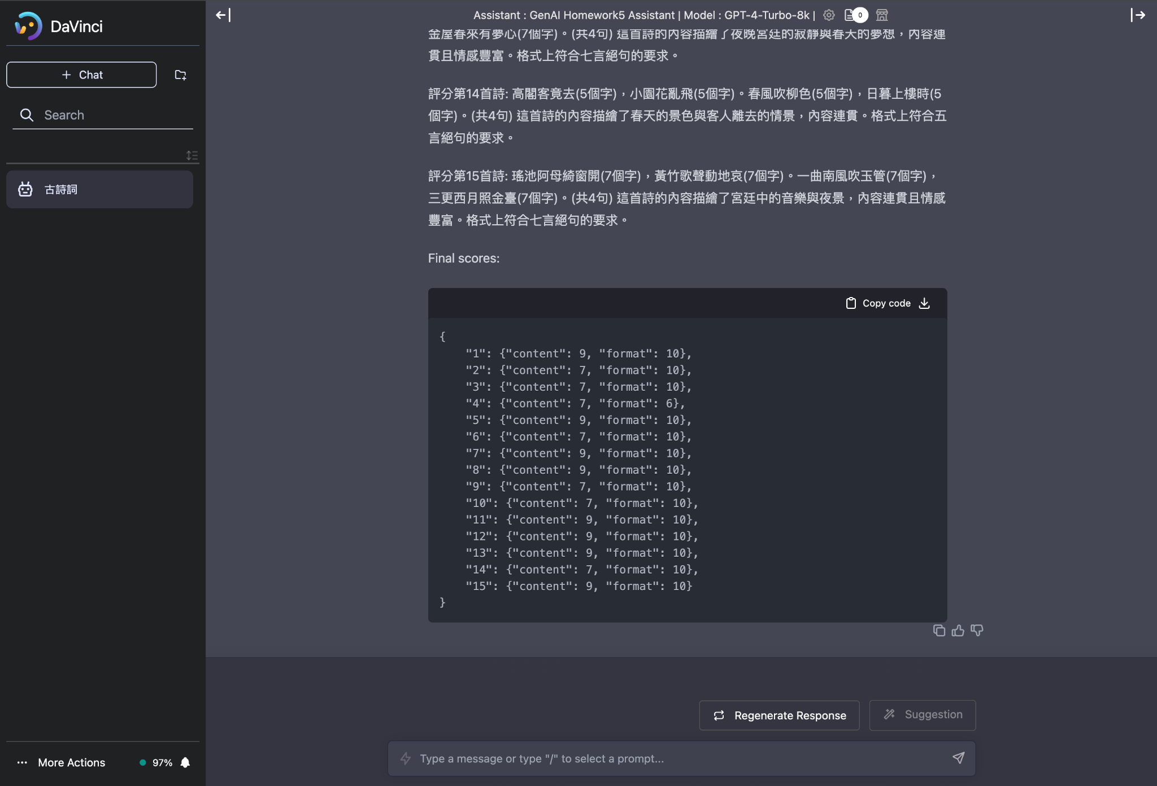
5. Assistant gives feedback and a final score for your each poem
⚠️ Ensure that check you have 15 Content Final Score and
15 Format Final Score

Slide 52
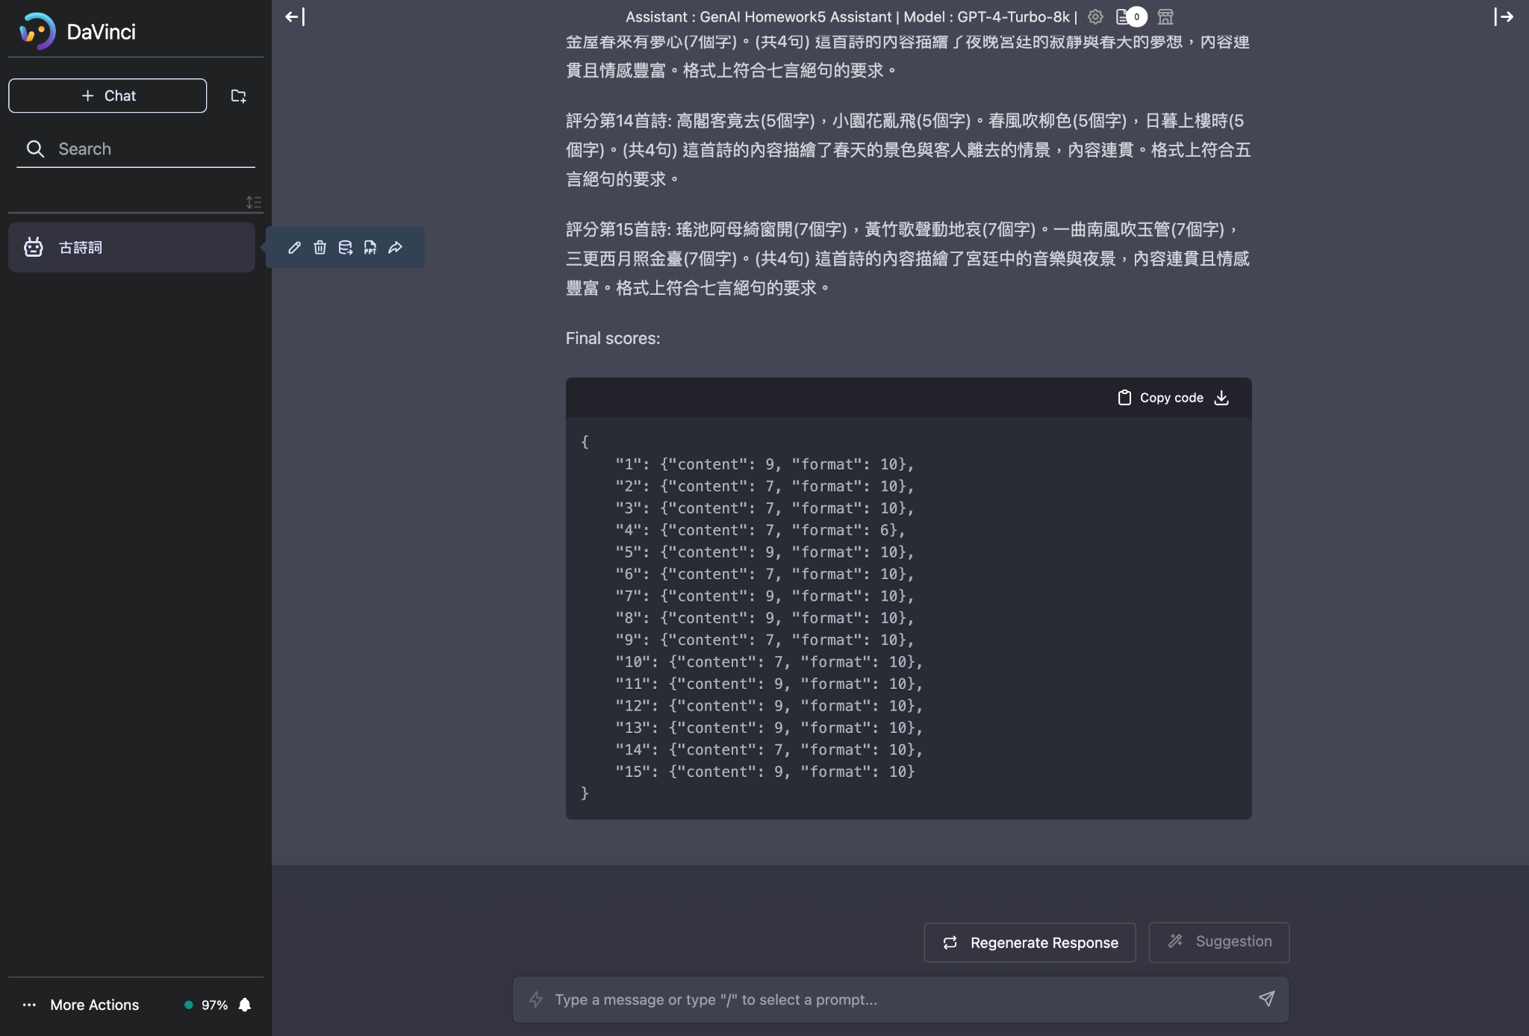
6. Export the result into a JSON file
⚠️ If there are good results, you can save them first to avoid any unexpected circumstances.

Slide 53
Grading Rules
Plagiarism in any form is prohibited.
Do NOT share your report answers & evaluation results (JSON files) with others.
Do NOT submit the JSON files that are not obtained using your Davinci account.
Do NOT attempt to manually edit your JSON file’s content.
Do NOT submit the original tang poems which are not generated by LLMs.
Do NOT changes any setting of assistant, including the prompts
第一次違反以上規定，該作業0分，學期總成績再乘以0.9
第二次違反以上規定，學期成績F
If you submit wrong JSON file, you will get 0 point.
Any format errors will results in 0 point. (ex: submitting .txt or .png instead of .json)
Prof. Lee & the TAs preserve the rights to change the rules & grades.

Slide 54
Submission & Deadline
Submit your homework to NTU Cool
Submission format
<student_id>.json from Davinci platform
2024/04/11 23:59:59 (UTC+8)
No late submission is allowed

Slide 55
Grading Release Date
The grading of the homework will be released by 2024/04/26 23:59:59 (UTC+8)

Slide 56
Grading – How to verify your submission file
Demo

Slide 57
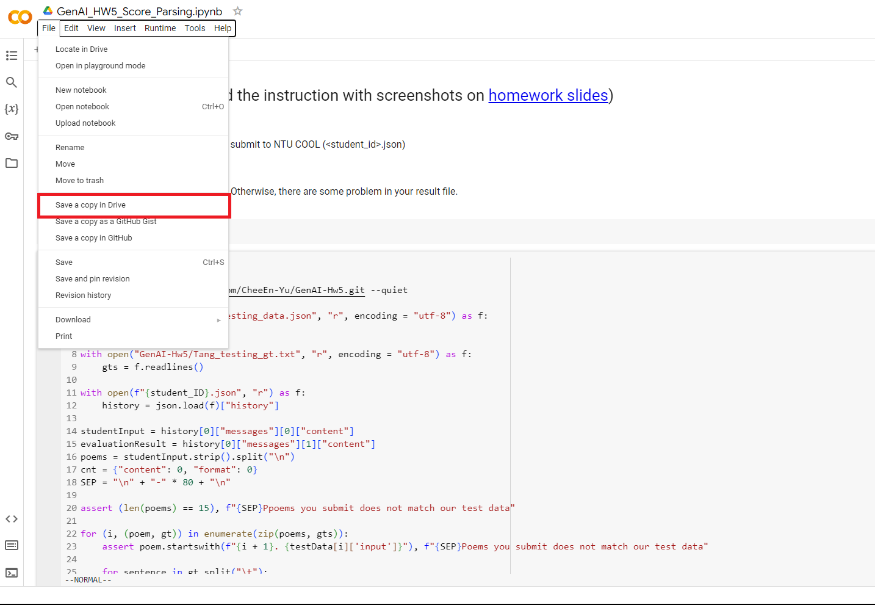
Open the link to the score parsing program and save a copy to your Drive

Slide 58
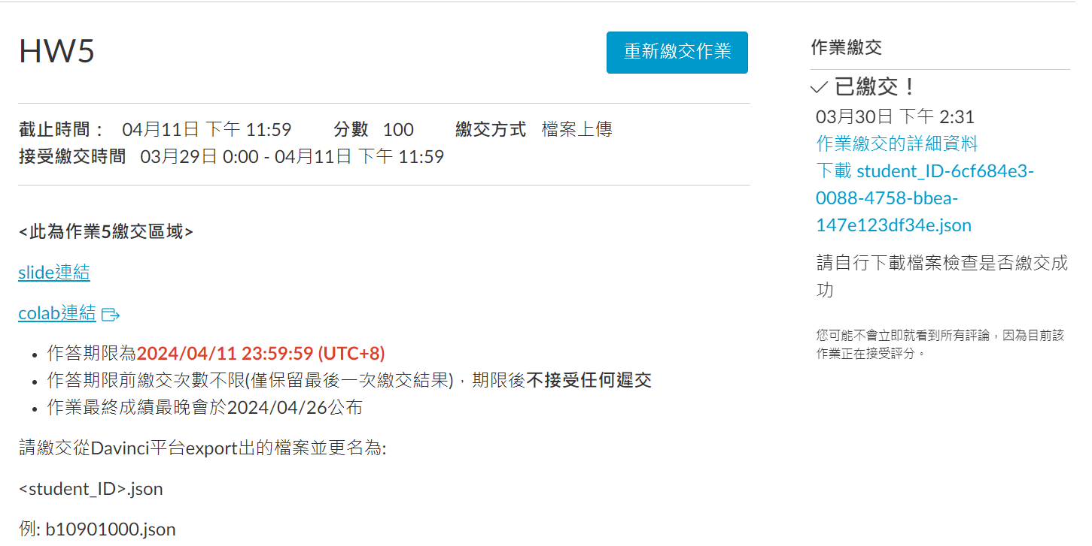
Download your submission file from NTU COOL
(If you’ve uploaded multiple times, NTU COOL will append “-1”, “-2”, … or some random string to the file name. You can simply ignore them.)

Slide 59
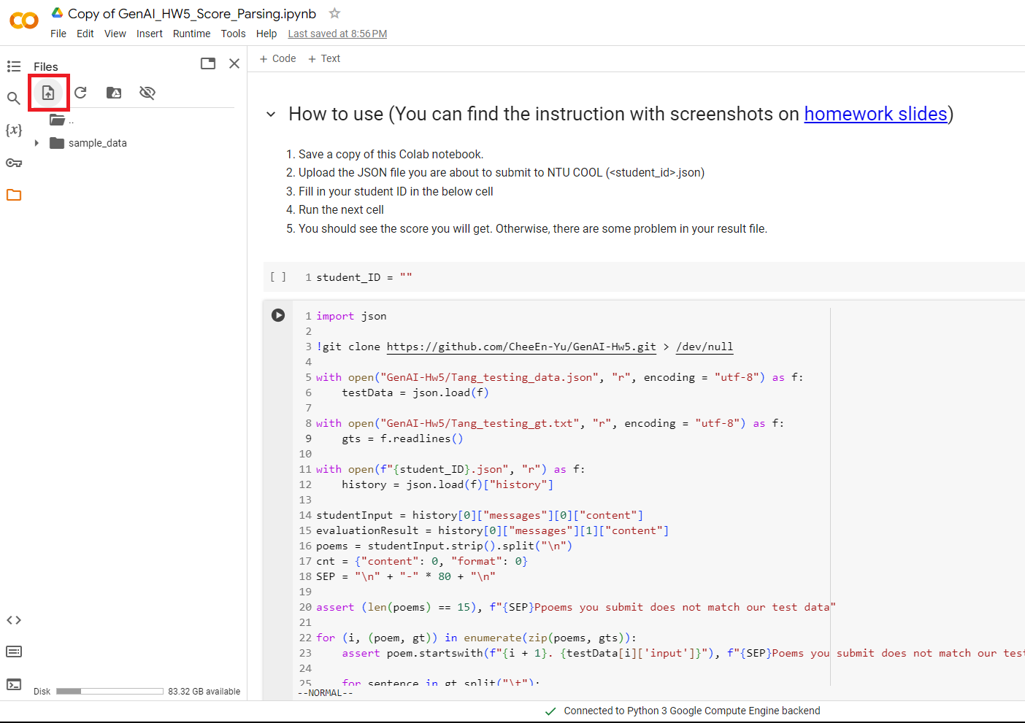
Upload the file you just downloaded.

Slide 60
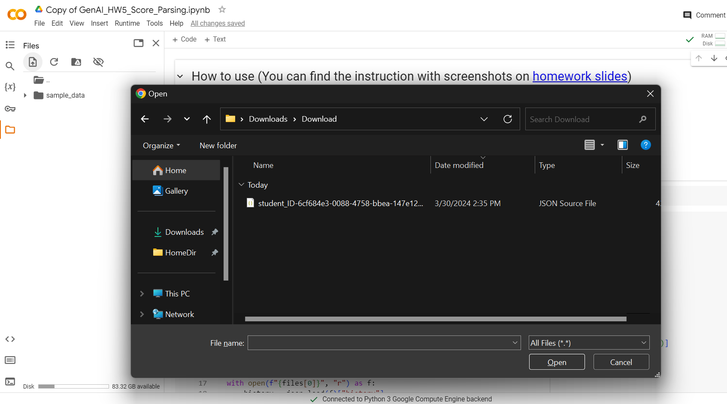
Upload the file you just downloaded.

Slide 61
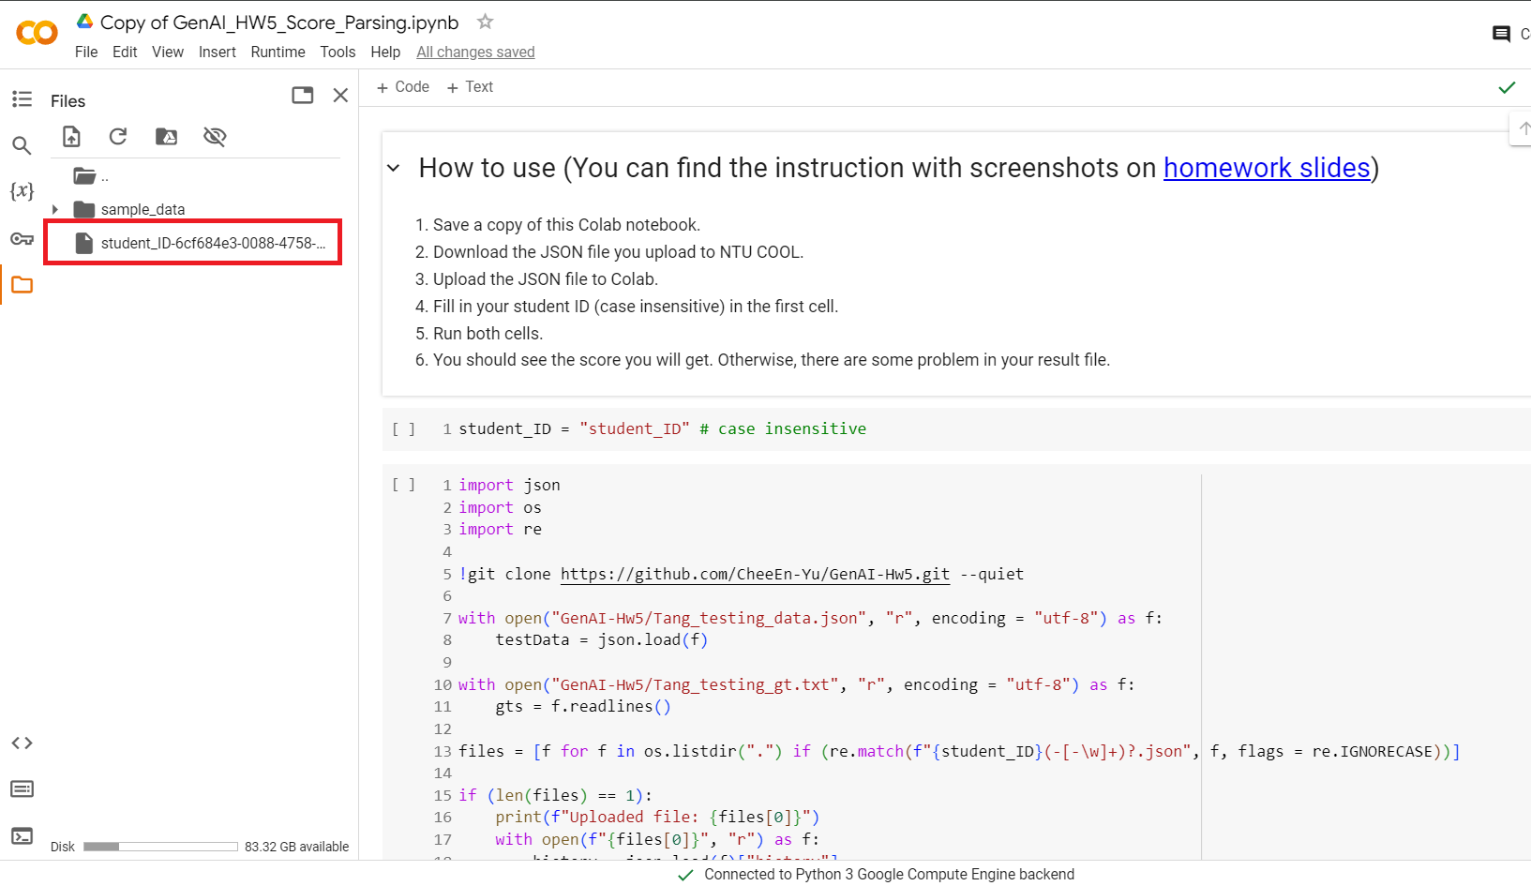
Your file should appear in the side panel

Slide 62
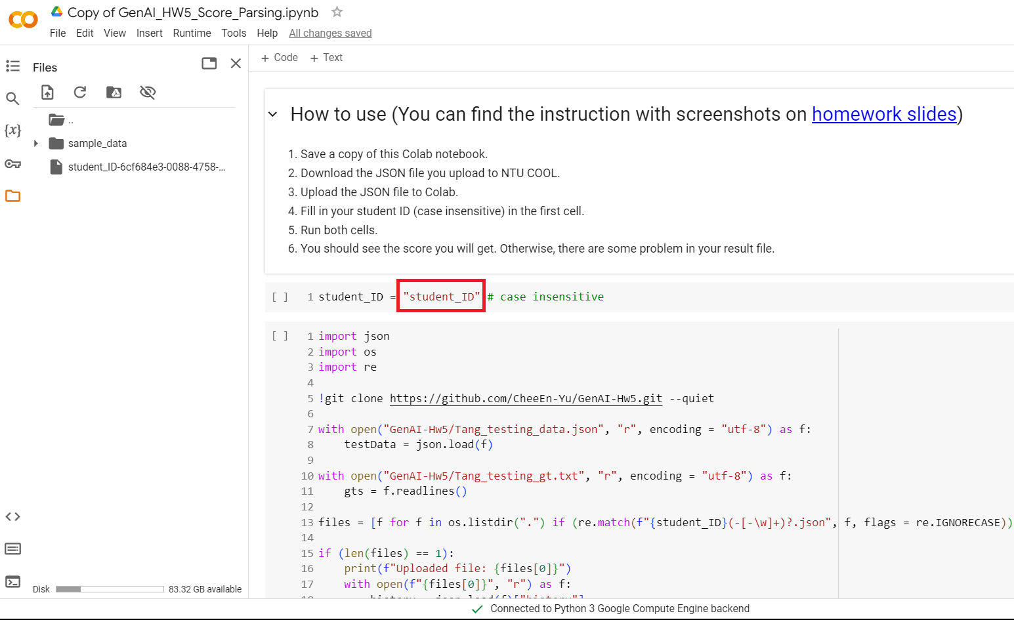
Fill in your student ID in the first cell.
(Don’t copy from the file name so that you can also check whether the ID in file name is correct)

Slide 63
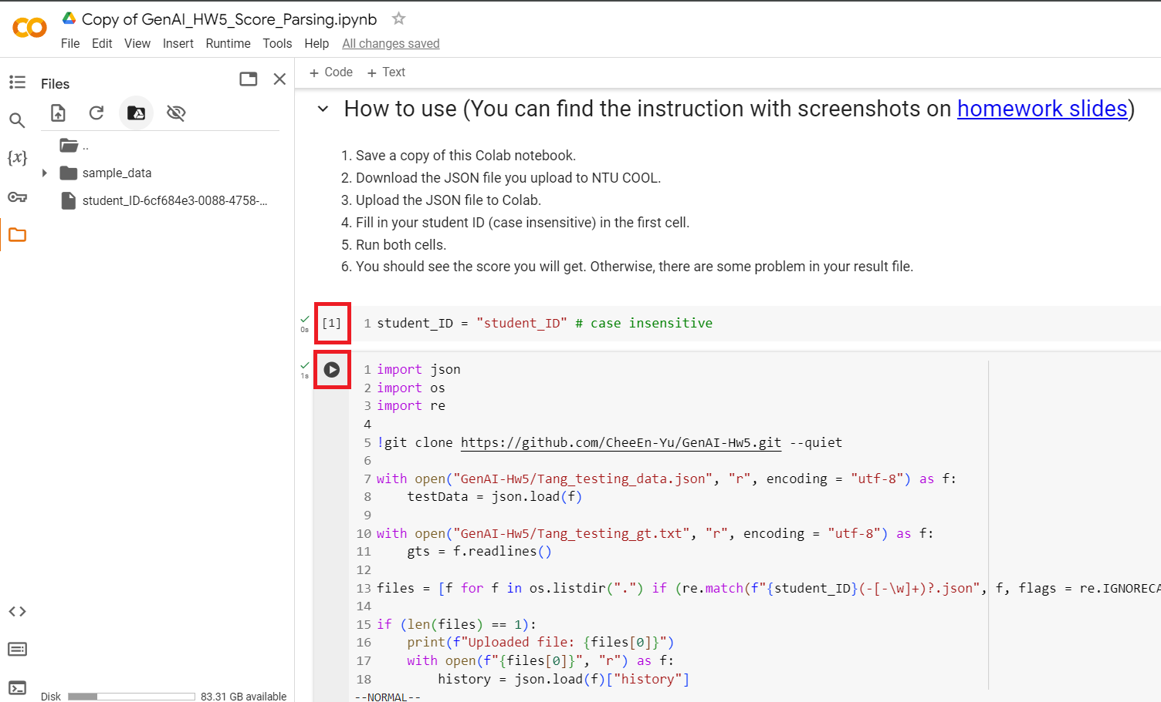
Run both cells by clicking the play button

Slide 64
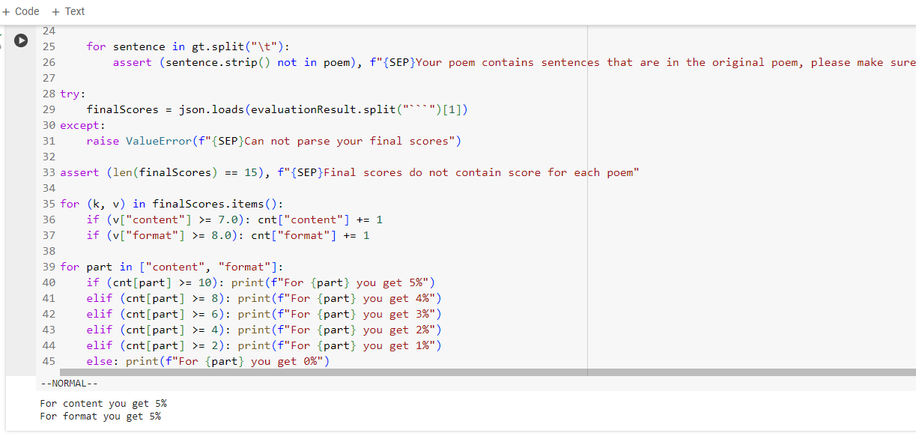
If you see this, it means your submission file is fine, and this should be the credits you’ll get

Slide 65
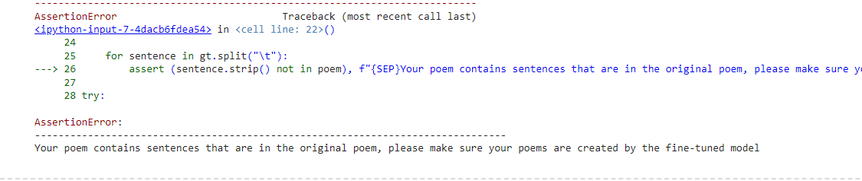
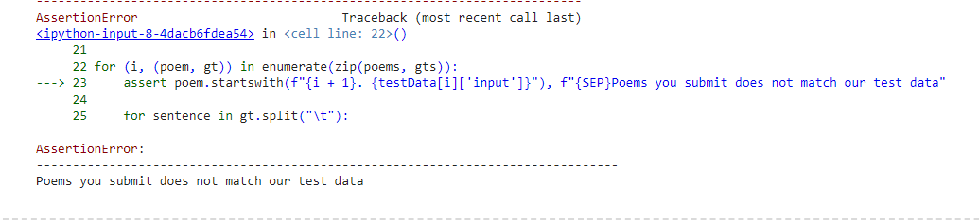
If you see something like these, it means there are some problem in your submission file.
If you cannot figure out what problem it is, please reach out to TAs.

Slide 66
If You Have Any Questions
NTU Cool HW5 作業討論區
如果同學的問題不涉及作業答案或隱私，請一律使用NTU Cool 討論區
助教們會優先回答NTU Cool討論區上的問題
Email: ntu-gen-ai-2024-spring-ta@googlegroups.com
Title should start with [GenAI 2024 Spring Hw5]
Email with the wrong title will be moved to trash automatically
TA Hours
Time: 3/29 (Fri.) 16:30 ~ 17:20, 4/5 (Fri.) 14:20 ~ 16:20 (online meet)
Location: 綜合大講堂

Slide 67
Appendix - How to activate GPU
A GPU(Graphics Processing Unit) is a hardware component designed to accelerate the process of training models.
Ensure that it is activated prior to commencing the training process

Slide 68
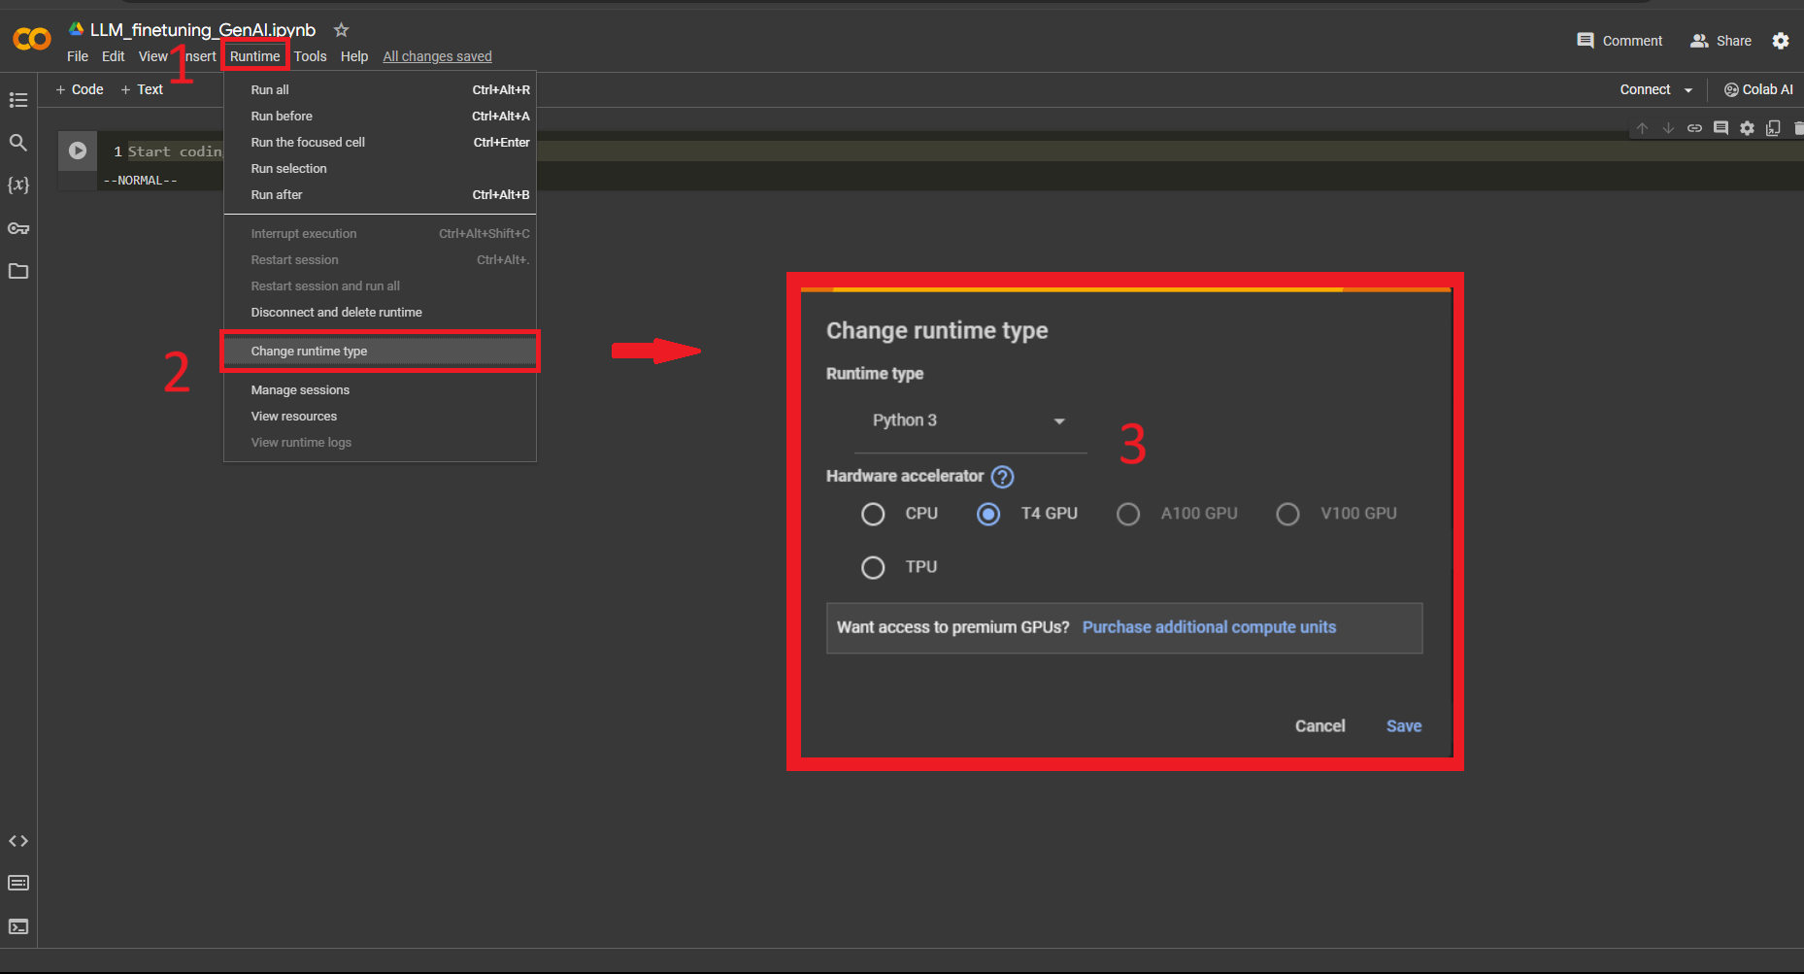
Appendix - How to activate GPU
A GPU(Graphics Processing Unit) is a hardware component designed to accelerate the process of training models.
Make sure to activate it before training.

Slide 69
Appendix - Choose adapter on different steps
Feel free to select the LoRA adapter at various stages of training and observe the variance in model output.
In sample code, we opt for the adapter from the last steps.

Slide 70
Appendix - Friendly Reminder
This assignment marks the first attempt at training models for this course. During the training process, there may be encounters with bugs or poor training outcomes.
However, as the teacher mentioned in the first class, it is hoped that these negative experiences can serve as side effects of a vaccine, aiding all students in facing greater challenges in the future after completing this training assignment.

Slide 71
Other Ref.
[2106.09685] LoRA: Low-Rank Adaptation of Large Language Models
Taide model
聯發科模型

